Slide 1
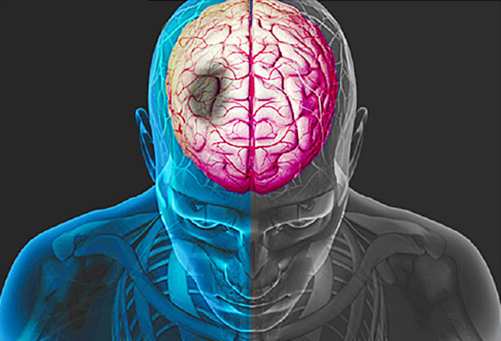
Interesting case
R3 ธีรวัฒน์ คุณาธินันท์
อาจารย์ณัฐธพงษ์ ภูวโชติโรจนโภคิน

Slide 2
Case 50 years-old male
Dx : Rt MCA infarction c IICP
Op: Wide decompressive craniectomy

Slide 3
Case 50 years-old male
Chief complaint : เวียนศีรษะ ปากเบี้ยว 15 min PTA
Present illness : 15 min PTA มี เวียนศีรษะ ปากเบี้ยว อ่อนแรง ไป รพ เอกชน ct brain Dx acute ischemic stroke
-- > rTPA --> refer รพ.พระมงกุฎเกล้า
At ward :GCS E4V5M6 → E2V2M2
on ETT

Slide 4
R 1 ซักประวัติเพิ่มเติม

Slide 5
Past history
s/p MVR ตค 59→ GA c ETT
Mitral valve prolapse c severe MR→ MV repair
on warfarin off → กพ 60
No complication
No hx difficult intubation

Slide 6
Past history
No history of drugs or foods allergy
No history of CVA , IHD
NO hx smoking
Alcohol drinking (social)
No hx motion sickness
FC II

Slide 7
Current medication
Atorvastatin(40) 1x1 o PC
Furosemide (40) 0.5 x 1 PC
Metoprolol(100) 0.25 x 1 PC

Slide 8
R 1 physical exam & investigation

Slide 9
Physical examination
Vital signs
BP 138/81 mmHg PR 76 bpm
Tempt 37.0 °C RR 16 breaths /min
GA : drowsiness
BW 75 kg, Height 173 cm (BMI 25.0 kg/m²)

Slide 10
Physical examination
HEENT : not pale, no jaundice
Airway : on ETT no 8 depth 23 cm
ventilator setting Pi 10 RR 14 FiO2 0.3 PEEP 5
Pulmonary equal breath sound both lung , no crepitation

Slide 11
Physical examination
CVS :surgical scar at chest wall, pulse full and regular ,PMI at 5 th ICS MCL, pansystolic murmur gr III radiate to axillary
Abdomen : soft , liver&spleen not palpable
Ext : no ecchymosis , no pitting edema

Slide 12
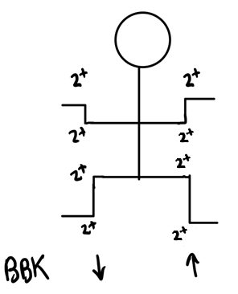
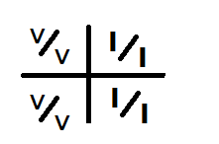
Physical Examination
Neurological examination :
E₂M₂V_{T}
Pupil 3 mm RTLBE ,RAPD –neg ,gaze deviate to Rt
Lt facial palsy
LT homonymous hemianopia
Motor grade
DTR 2+ all
Decrease gag reflex
Tongue and uvular in midline

Slide 13
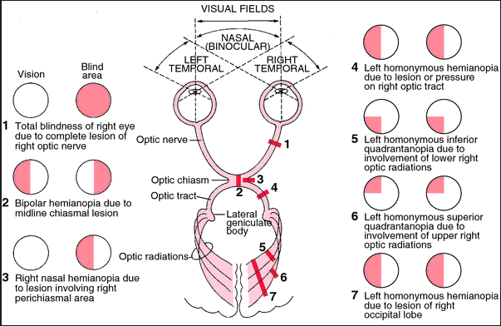

Slide 14
Investigation

Slide 15
Investigation
complete blood count
BUN, creatinine
Electrolytes
ABG
ECG
CXR
Coagulogram
Echocardiogram
CT brain

Slide 16
Investigation
CBC : WBC 10,900/ul Hct 39.5%, Hb 13 mg% Platelet 203,000/mm³
Electrolytes : Na 141, K 3.82, Cl 107, CO₂19
BUN/Cr 93 /0.75mg/dL (GFR 107 )
FBS: 88 mg%
UA: pH 6 ,SpGr. 1.020 , protein neg ,wbc 0-1 , rbc 5-10,

Slide 17
Investigation
Coagulogram
aPTT 26 sec/ratio 0.99
PT 16.2 sec/ratio 1.24
TT 15.70 sec/1.59

Slide 18
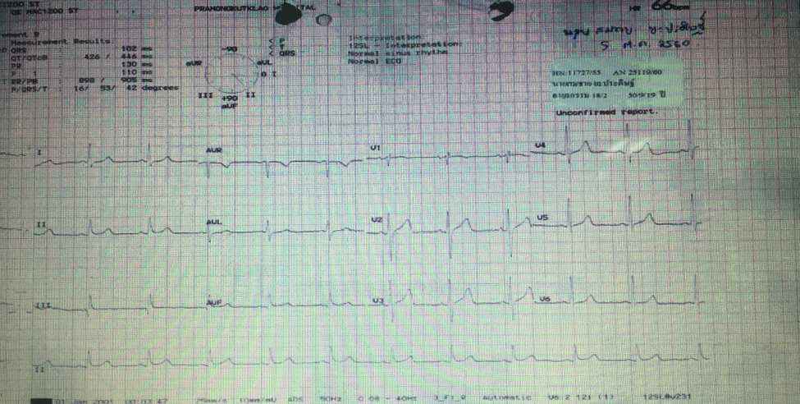
ECG

Slide 19
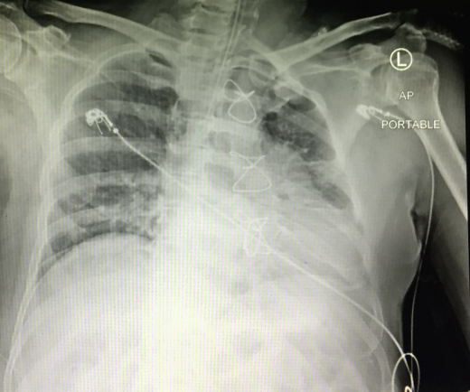
CXR

Slide 20
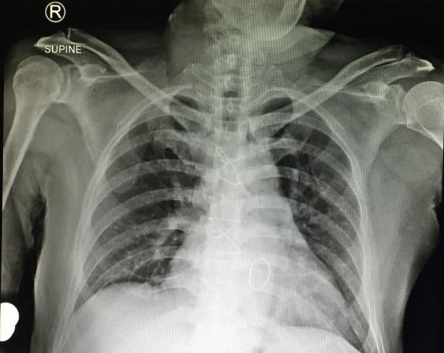
CXR

Slide 21
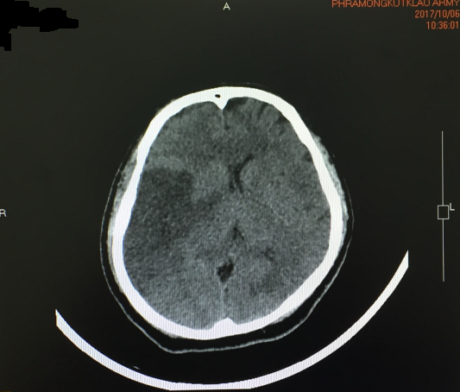
CT brain

Slide 22
CT brain
Hypodensity area right fronto-pariato-temporal lobe ,posterior limb of internal capsule
Progression of brain edema , midline shift to the left 0.8 cm
Impending right uncal herniation
No tonsillar herniation
No ICH
No hydrocephalus

Slide 23
Echocardiography
Mild LV dilatation
Preserved LV systolic function
Mild concentric LVH
No RWMA
Mild TR
Normal RVSP
Normal diastolic function
Moderate MR

Slide 24
R1 problem lists & ASA clssification

Slide 25
Problem lists

Slide 26
Problem lists
Acute ischemic stroke c increase ICP c brain herniation
Severe MR s/p MV repair
HT

Slide 27
ASA Classification
ASA IV E

Slide 28
R2 preoperative evaluation & prepraration

Slide 29
Preoperative evaluation&prepraration

Slide 30
Acute ischemic stroke c IICP
Neurological exam
Localizing signs
Signs of IICP
Management
Airway and mechanical ventilation
Hemodynamic support and blood pressure management
Glucose management
Temperature management
ICP management
DVT prophylaxis
Seizure prophylaxis

Slide 31
NIHSS
NIHSS (National Institute of Health Stroke Scale)
Standardized method used by health care professionals to measure the level of impairment caused by a stroke
Purpose
Main use is as a clinical assessment tool to determine whether the degree of disability is severe enough to warrant the use of tPA
Another important use of the NIHSS is in research, where it allows for the objective comparison of efficacy across different stroke treatments and rehabilitation interventions
Scores are totaled to determine level of severity
Can also serve as a tool to determine if a change in exam has occurred
Notes:
The National Institute of Health Stroke Scale is the industry standard
It is also a research tool that allows us to quantify our clinical exam

Slide 32
NIHSS
NIHSS Interpretation
Stroke Scale | Stroke Severity
0 | No Stroke
1-4 | Minor Stroke
5-15 | Moderate Stroke
15-20 | Moderate/Severe Stroke
21-42 | Severe Stroke

Slide 33
NIHSS and Outcome Prediction
NIHSS below 12-14 will have an 80% good or excellent outcome
NIHSS above 20-26 will have less than a 20% good or excellent outcome
Lacunar infarct patients had the best outcomes
Adams HP Neurology 1999;53:126-131
Baseline NIH Stroke Scale score strongly predicts outcome after stroke (TOAST)
Notes:
Study done by Adams and his colleagues used the Barthel Index (BI) and the Glasgow Outcome Scale (GOS) to assess over 1200 patients’ outcomes at 7 days and 3 months.
Between 70% and 80% of patients who have suffered a lacunar stroke are functionally independent at 1 year, compared with fewer than 50% of patients who have had a nonlacunar stroke.

Slide 34
Determining the Location
Large Vessel:
Look for cortical signs
Small Vessel:
No cortical signs on exam
Posterior Circulation:
Crossed signs
Cranial nerve findings

Slide 35
Cortical Signs
RIGHT BRAIN: | LEFT BRAIN:
- Right gaze preference | - Left gaze preference
- Neglect | - Aphasia
If present, think LARGE VESSEL stroke
Notes:
Cortical Signs

Slide 36
Large Vessel Stroke Syndromes
MCA:
Arm>leg weakness
LtMCA cognitive: Aphasia
RtMCA cognitive: Neglect,, topographical difficulty, apraxia, constructional impairment
ACA:
Leg>arm weakness
Cognitive: muteness, perseveration, abulia, disinhibition
PCA:
Hemianopia
Cognitive: memory loss/confusion, alexia
Cerebellum:
Ipsilateral ataxia
Notes:
Abulia - Loss or impairment of the ability to make decisions or act independently
Anosonosia - complete unawareness or denial of a neurologic deficit.

Slide 37
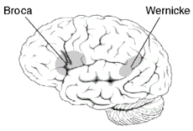
Aphasia
Broca’s
Expressive aphasia
Left posterior inferior
frontal gyrus
Wernicke’s
Receptive aphasia
Posterior part of the superior temporal gyrus
Located on the dominant side (left) of the brain

Slide 38
Neurological examination
E₂M₂V_{T}
Pupil 3 mm RTLBE ,RAPD –neg ,gaze deviate to Rt
Lt facial palsy
Lt homonymous hemianopia
Motor grade
DTR 2+ all
Decrease gag reflex
Tongue and uvular in midline

Slide 39
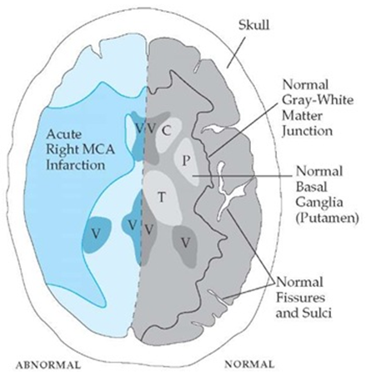
Neurological examination
Localization→ MCA infarction

Slide 40
Airway and Mechanical Ventilation
Maintaining normocarbia
Intubation may be considered for patients with decreased levels of consciousness resulting in poor oxygenation or impaired control of secretions

Slide 41
Hemodynamic Support and Blood Pressure Management
Aggressive treatment of worsening cardiac arrhythmias with appropriate medications and continued cardiac monitoring
Use of adequate fluid administration with isotonic fluids
Hypotonic or hypo-osmolar fluids are not recommended
Use of prophylactic osmotic diuretics before apparent swelling is not recommended

Slide 42
Hemodynamic Support and Blood Pressure Management
Blood pressure–lowering drugs may be considered for the treatment of extreme hypertension

Slide 43
Glucose Management
Hyperglycemia should be avoided, and glucose levels between 140 and 180 mg/dL are recommended
Tight glycemic control (glucose <110 mg/dL) is not indicated, but an insulin infusion may be used to avoid significant hyperglycemia
Hypoglycemia should be avoided

Slide 44
Temperature Management
Temperature management is part of basic support, and a normal temperature is reasonable
The effectiveness of the use of therapeutic hypothermia before brain swelling is not known

Slide 45
ICP Management
Routine ICP monitoring is not indicated in hemispheric ischemic stroke
Ventriculostomy is recommended in obstructive hydrocephalus after a cerebellar infarct but should be followed or accompanied by decompressive

Slide 46
Miscellaneous Medical Measures
Deep venous thrombosis prophylaxis with subcutaneous or low-molecular-weight heparin should be used
Intravenous heparin or combination antiplatelet agents are not recommended in patients with swollen strokes
Seizure prophylaxis in patients without seizures at presentation is not indicated

Slide 47
Severe MR s/p MV repair
Hx surgery
Anticoagulant
Last echo
Complication
IE prophylaxis

Slide 48
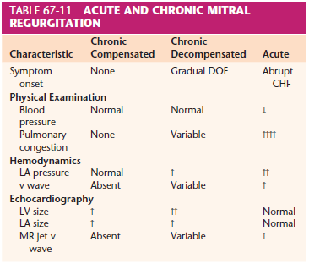

Slide 49
Severe MR s/p MV repair
Considerations
↑ risk of perioperative cardiac complications (MI/CHF)
Hemodynamic alterations associated with MR:
Left atrial volume overload & ↓ forward cardiac output (CO)
Potential for LV dysfunction (from overload)
Potential for arrhythmias (atrial fibrillation commonly) due to LA dilatation
Potential for pulmonary hypertension leading to RV dysfunction

Slide 50
Severe MR s/p MV repair
Considerations
Management of medical therapy:
ACE inhibitors, beta-blockers, digoxin, calcium channel blockers

Slide 51
Echocardiography
Mild LV dilatation
Preserved LV systolic function
Mild concentric LVH
No RWMA
Mild TR
Normal RVSP
Normal diastolic function
Moderate MR

Slide 52
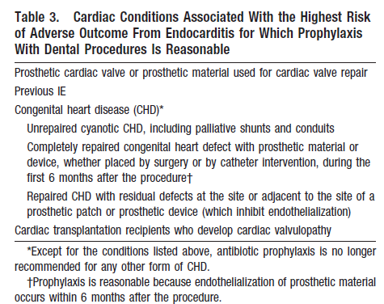
IE prophylaxis

Slide 53
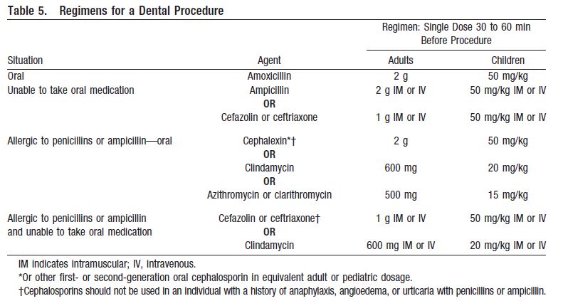
IE prophylaxis

Slide 54
Hypertension
End organ damage caused by long standing hypertension :
CVS : LVH, MI, CHF
Renal involvement : nephropathy
Cerebral involvement : TIA, stroke

Slide 55
Hypertension
Identified current therapy
Evaluated EKG, CXR, serum creatinine
Identified normal baseline BP
Notes:
- Uncontroll or untrated hypertension is C/I to controlled hypotension tecnique. Because cerebral autoregulation is shifted to right
Useful guideline is decrease 25% of MAP to lower limit of autoregulation
Anti hypertensive drug : diuretic cause hypoK hypomg ,
LVH increase risk of MI
Elective surgery : BP > 230/130 (180/110)should be postpone , HT emergency → should be admit for iv control
Hypertensive urgency : rest and control BP
Control diastolic BP <110

Slide 56
Preparations
Inform consent
NPO
Force air warmer
Warm IV fluid
Foley cath
Icu post op
Acute ischemic stroke
Large bore IV
Blood component : PRC 4,FFP 4,Plt 10
Antihypertensive drugs : Esmolol , Nicardipine
Vasopressor : Norepinephrine
Mannitol
Antiepileptic
Mitral valve regurgitation
Inotropic drug : dopamine, dobutamine
ATB for IE prophylaxis

Slide 57
Preparation & premedication
Monitoring
Standard monitoring : NIBP,O₂sat,ETCO₂ EKG , Temperature
Invasive monitoring : A line , C-line ?
Other : urine output
Positioning
Supine
Notes:
EEG -> guide flow interruption / CMR reducing anesthetic agent
Reveal major ischemic event
SSEP ใช้ได้ทั้ง anterior posterior circulation
Vertebro basillar aneurysm -> EEG ใช้น้อย, ใช้ BAEP,SSEP

Slide 58
Choice of anesthesia
GA c ETT

Slide 59
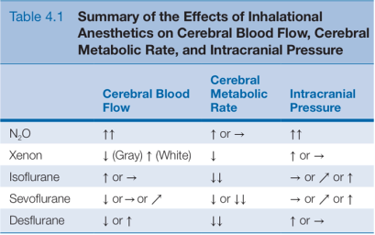
Effect of anesthetic drugs

Slide 60
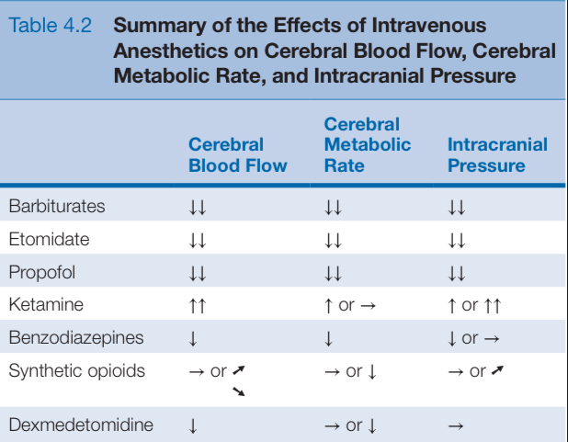

Slide 61
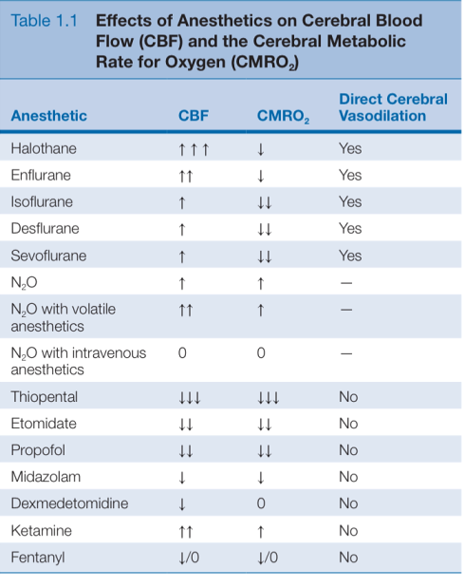

Slide 62
R3 anesthetic considerations

Slide 63
Anesthetic consideration

Slide 64
Intraoperative Management
Maintain CPP
Cerebral protection prevent secondary brain injury
Adequate brain relaxation
Balance fluid and electrolytes
Allow rapid emergence
Adequate IV access

Slide 65
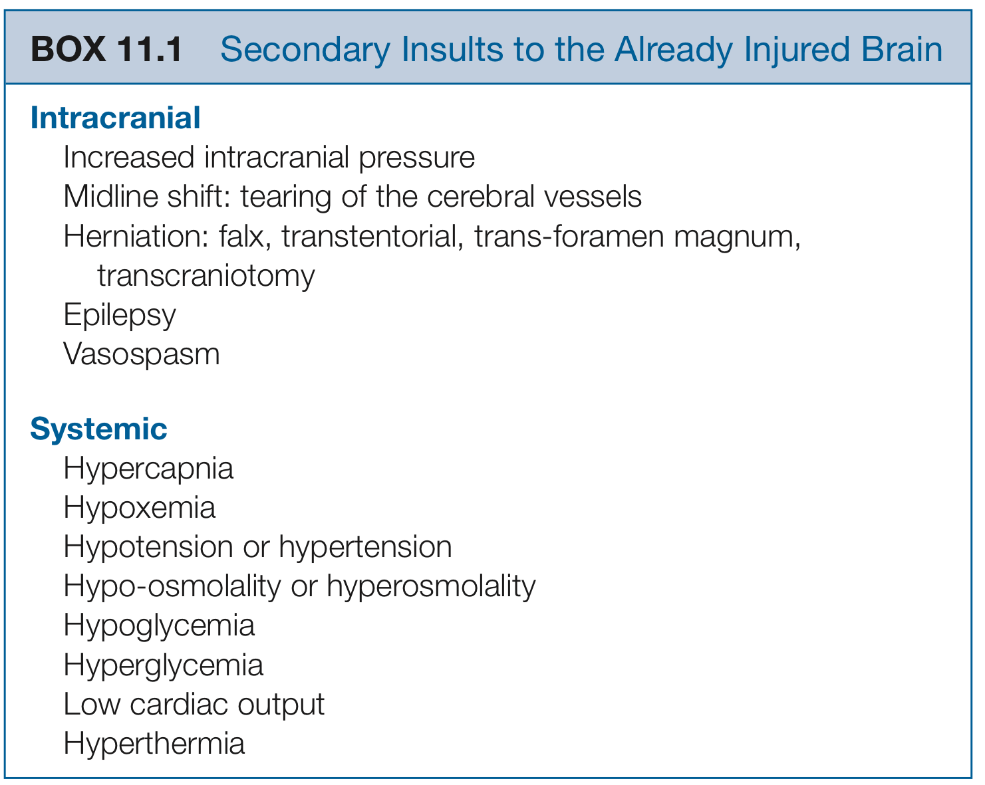
Intraoperative Management
Cerebral protection
Cottrell and Patel's Neuroanesthesia, 6th Edition

Slide 66
Intraoperative Management
BP Management
The goal is to maintain cerebral perfusion!!
CPP = MAP – ICP
Higher BP goals with Ischemic stroke
Lower BP goals with Hemorrhagic stroke (avoid hemorrhagic expansion, especially in AVMs and aneurysms)
Notes:
For the most part, ICH stroke guidelines recommend using IV medications to lower SBP < 160 while still maintaining adequate MAP and CPP
Ischemic strokes are a bit trickier to manage. One must keep in mind that the patient’s blood pressure will lower on its own by approximately 25 – 30 % within the first 24 hours.
Furthermore aggressive treatment of hypertension in ischemic strokes has been shown to worsen neurological function by reducing perfusion pressure
Castillo and collegues performed a study in 2004 that showed that a drop in either SBP or DBP > 20 points were associated with higher rates of mortality and larger volumes of infarctions. They also noted that early administration of antihypertensinve medications to patients with SBP > 180 was associated with an increased risk of death.
**** CHHIPS trial ***
According to the guidelines, sbp should be reduced by 15 – 25% within the first day as excessively high blood pressures are associated with an increased risk of hemorrhagic conversion.

Slide 67
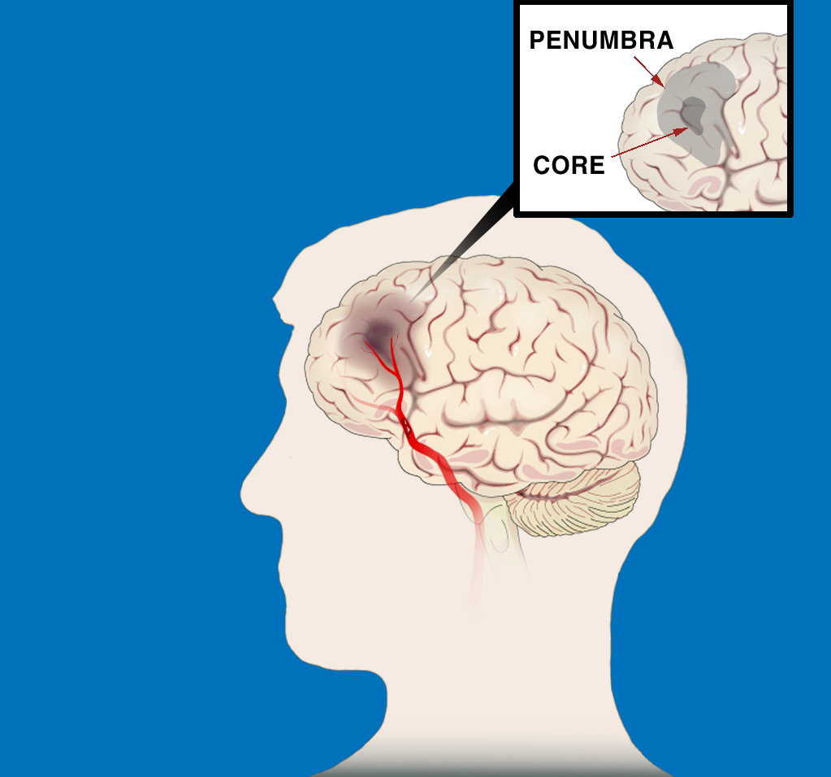
BP-AIS Relationship
BP increase is due to arterial occlusion (i.e., an effort to perfuse penumbra)
Failure to recanalize (w/ or w/o thrombolytic therapy) results in high BP and poor neuro outcomes
Lowering BP starves penumbra, worsens outcomes
Penumbra
Core
Clot in Artery
Notes:
In AIS, high BP is a response,
not a cause—don’t lower it!

Slide 68
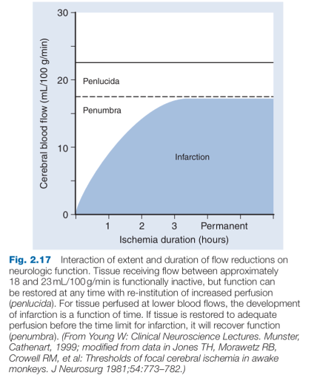

Slide 69
Save the Penumbra!!
Normal function
20
15
Neuronal dysfunction
CBF
8-18
PENUMBRA
10
5
CORE
Neuronal death
CBF
< 8
1
2
3
TIME (hours)
CEREBRAL
BLOOD
FLOW
(ml/100g/min)

Slide 70
Intraoperative Management
Blood sugar control
Avoid Hypo/Hyperglycemia
glucose levels between 140 and 180 mg/dL
Avoid Anemia
Target Hb 9 - 10 g/dl

Slide 71
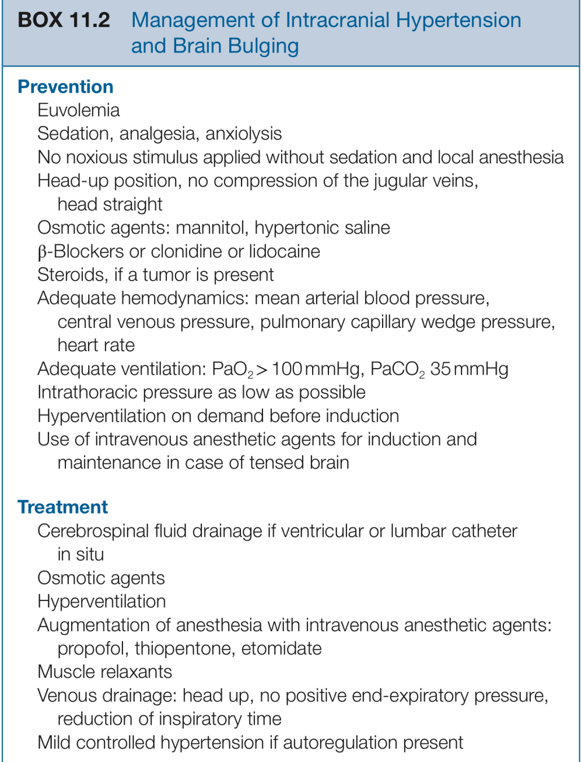
Intraoperative Management
Brain relaxation
20% Mannitol 0.5 - 2 gm/Kg IV over 30 min

Slide 72
Intraoperative Management
Anesthetic goal in mitral regurgitation
Maintain forward flow & ↓ regurgitant fraction:
Preload: maintain preload but avoid overload (↑ risk for CHF)
Rate: high-normal rate (80-100bpm) & avoid bradycardia (longer diastole = more regurgitation)
Rhythm: sinus rhythm
Contractility: maintain or enhance contractility to improve forward flow & reduce regurgitant fraction by constricting mitral valve annulus
Afterload: reduce afterload to enhance forward flow
Avoid ↑ in pulmonary vascular resistance to mitigate right heart failure (avoid hypoxia, hypercarbia, acidosis, pain)

Slide 73
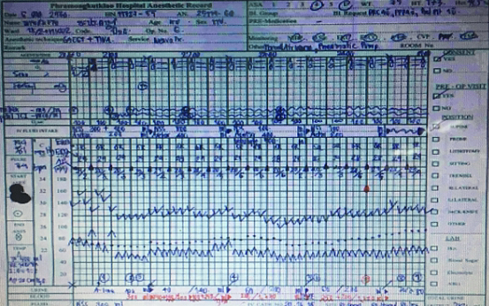
BP at OR 144/81 PR 79
E2VtM4
Thiopental 50 mg
Nimbex 8 mg
Access a-line
ETT No 8 depth 23 cm
Air:O2 1:1
Propofol TCI 3-4 mcg/ml
Nimbex(1:1) 4 ml/hr
Cefazolin 1 gm iv before procedure

Slide 74
ABG
21.12: Hb/Hct 14.2/43 pH 7.43 PaCO2 34 HCO3 22 PaO2 289 Na 141 K3.3 Cl 108 BE -1.4 Dtx 122
23.44 Hb/Hct 9.6/29 pH 7.41 PaCO2 36 HCO3 22 PaO2 268 Na 140 K3.3 Cl 102 BE - 2.2 Dtx 125

Slide 75
Urine output 0.5-1 ml/hr
Keep PaCO2 30-35 mmHg
Keep MAP 70-80 mmHg

Slide 76
Op time 5 hr 30min
Fentanyl 100 mcg
Reverse neostigmine 2.5 mg atropine 1.2 mg
I/O 3163/280
Fluid crystalloid NSS 1400 acetar 1300
colloid voluven 500
blood compenent PRC 1 u
EBL 1800 ml

Slide 77
Post operative(day1)
S :ตื่นรู้ตัว ทำตามสั่งได้ ยังมีอ่อนแรง มีไข้
O:BT 38.1 PR 88 BP 158/ 70 RR 18
Neuro :E3VtM6 pupil 3mm RTLBE
motor
CVS: pansystolic murmur gr III radiate to axillary
Respiratory :clear , equal breath sound both lung
A+P:
Hemato : hct 26.9 , plt 246000 no bleeding , no ecchymosis
GU : Cr 0.79 e’lyte –normal
I/O 1850/3300
GI :NPO , abdomen soft no guarding no distension
omeprazole 40 mg iv od
Neuro: good consciousness , on dilantin 100 mg iv q 8 hr
Respiratory : ventilator PCV Pi 10 PEEP 5 FiO2 0.3 RR 14 → f/u ABG
Endocrine : Dtx q 6 hr keep 80-180 mg%
Pain : fentanyl 50 mcg iv prn q 4 hr

Slide 78
Post operative(day2)
S :ตื่นรู้ตัว ทำตามสั่งได้
O:BT 37.8 PR 92 BP 150/ 70 RR 18
Neuro :E4VtM6 pupil 3mm RTLBE
motor
CVS: pansystolic murmur gr III radiate to axillary
Respiratory :clear , equal breath sound both lung
A+P:
Hemato : hct 29 , plt 156000 no bleeding , no ecchymosis
GU : Cr 0.79 e’lyte –normal
I/O 400/350
GI :NPO , abdomen soft no guarding no distension
Neuro: good consciousness , on dilantin 100 mg iv q 8 hr
Respiratory : off ETT no dyspnea
Endocrine : Dtx q 6 hr keep 80-180 mg%
Pain : fentanyl 50 mcg iv prn q 4 hr

